Slide 1


“DIGITAL IMAGE REPRESENTATION,TYPES OF IMAGES”
Department of Computer Science and Engineering
Acharya Institute of Technology
Soladevanahalli, Bengaluru 560 107
A Presentation on
by
ADITYA JYOTI SAHU-1AY21CS017
ADITYA ARUN KUMAR-1AY21CS016
ADITYA KSHATRIYA-1AY21CS018
ANISH KUMAR-1AY21CS028
UNDER THE GUIDANCE OF
VARALAKSHMI B D
ASSISTANT PROFESSOR
2023-2024

Slide 2
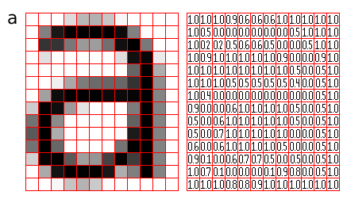
WHAT IS DIGITAL IMAGE
Digital image representation refers to the way images are stored, processed, and displayed in digital
Each pixel has a color value, which can be represented in different color models (e.g., RGB, grayscale).

Slide 3
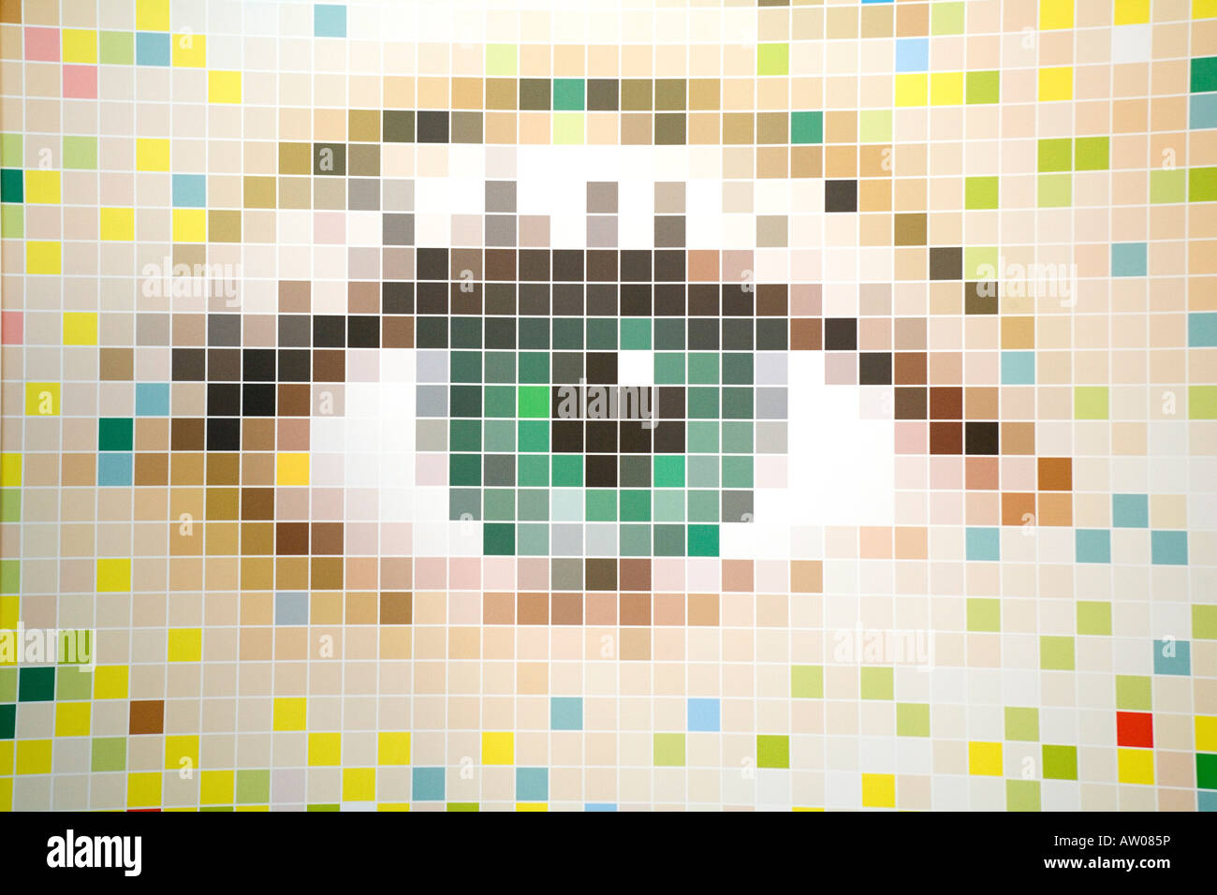
PIXELS
The smallest unit of a digital image, typically square-shaped.
Properties: Each pixel has a specific color or intensity value.

Slide 4
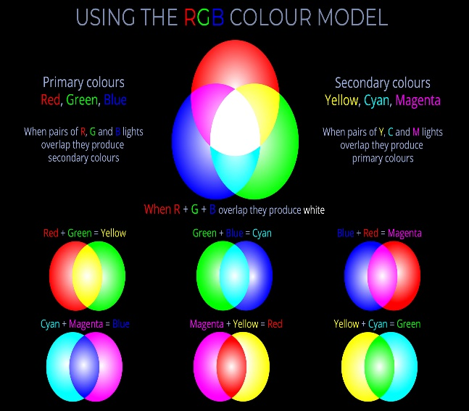
COLOR MODELS
Color Models:
RGB (Red, Green, Blue): Commonly used in digital displays. Each pixel is a combination of red, green, and blue values.
Example: (255, 0, 0) represents bright red.
CMYK (Cyan, Magenta, Yellow, Key/Black): Used in printing.
Grayscale: Each pixel has a single intensity value, representing shades of gray.
Example: 128 represents a medium gray.

Slide 5
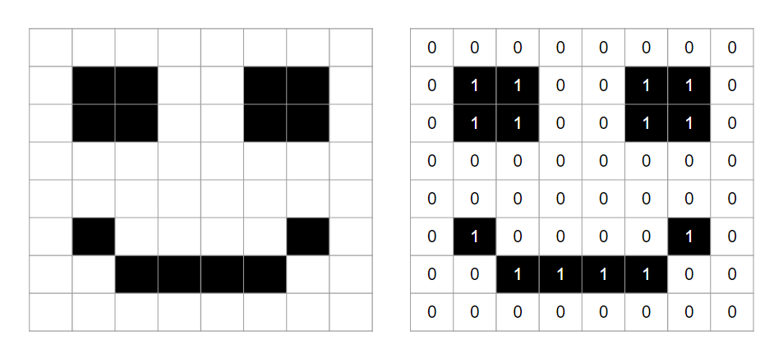
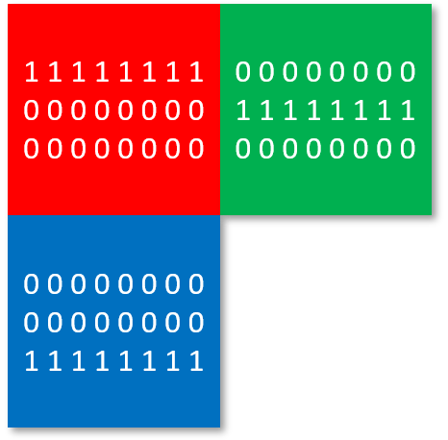
BIT DEPTH
Bit Depth:
Definition: The number of bits used to represent the color of a single pixel.
Examples:
1-bit: Black and white images (2 colors).
8-bit: 256 colors or shades of gray.
24-bit: True color (16.7 million colors), with 8 bits for each RGB channel.

Slide 6
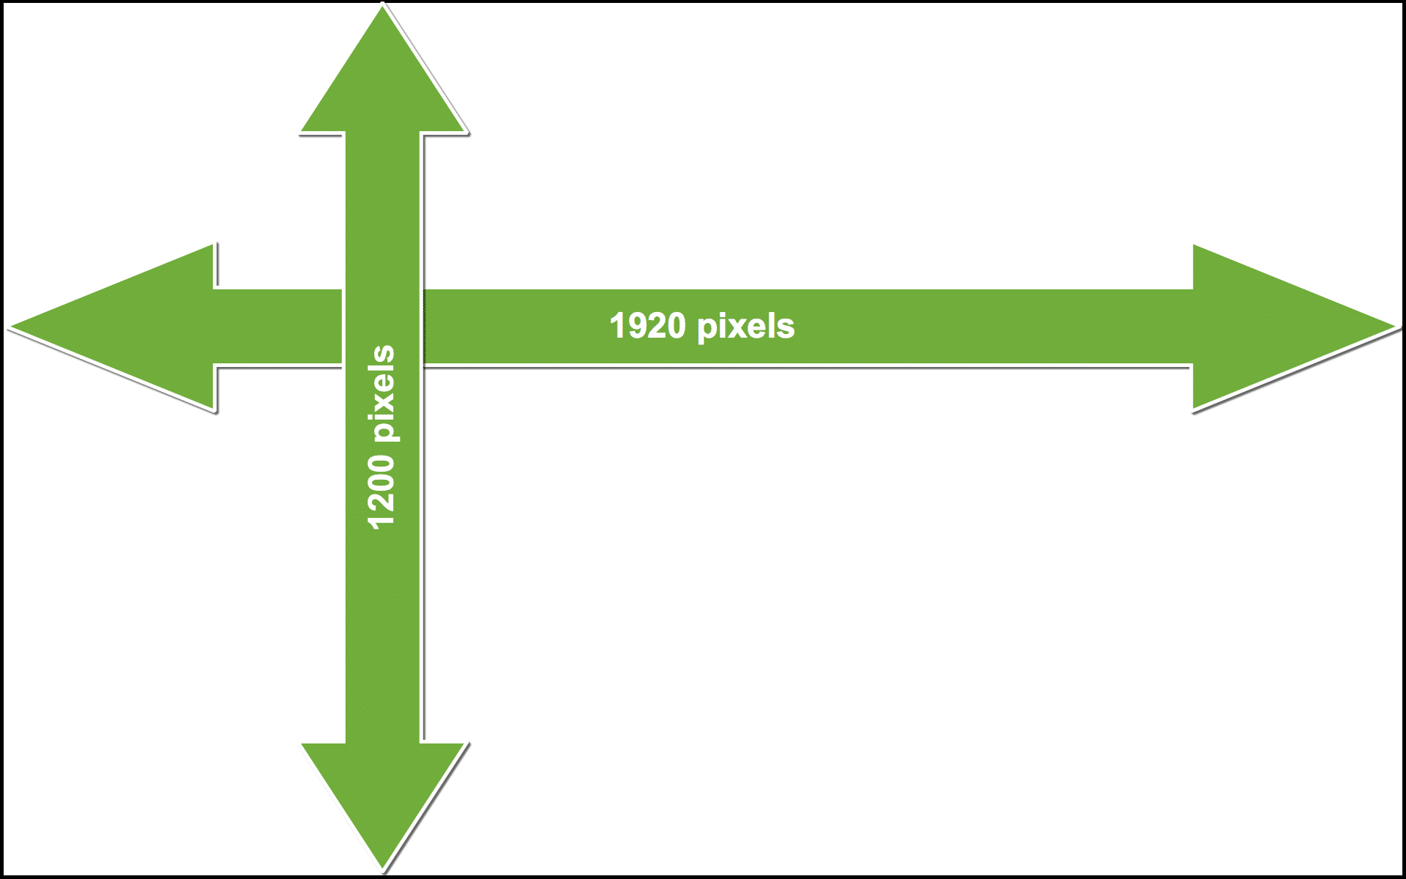
RESOLUTION
Resolution:
Definition: The number of pixels in an image, typically given as width x height (e.g., 1920x1080).
Impact: Higher resolution means more detail and larger file sizes.

Slide 7
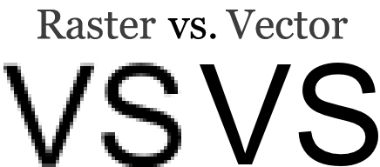
IMAGE FORMATS
Image Formats:
Raster: Images stored as a grid of pixels (e.g., JPEG, PNG, GIF).
Vector: Images stored as mathematical equations defining shapes (e.g., SVG, EPS). Not pixel-based and can be scaled without loss of quality.

Slide 8
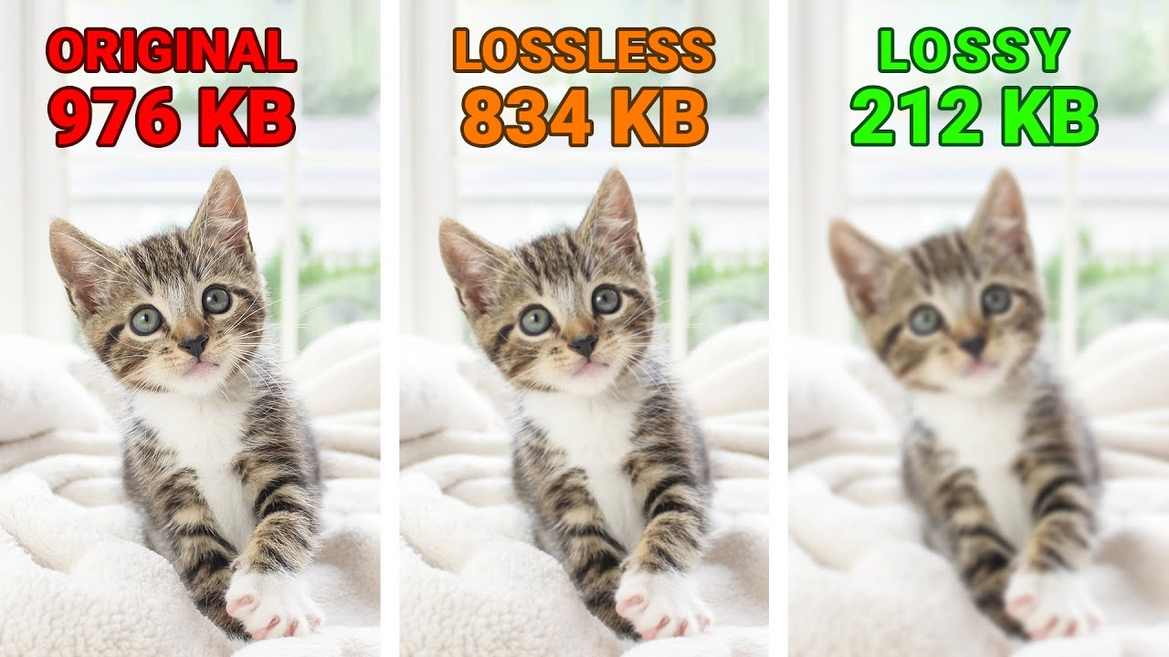
COMPRESSION
Compression:
Lossy Compression: Reduces file size by discarding some image data, resulting in reduced quality (e.g., JPEG).
Lossless Compression: Reduces file size without losing any image data (e.g., PNG, GIF).

Slide 9
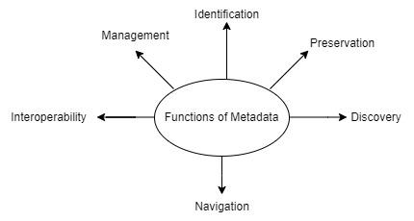
METADATA
Metadata:
Definition: Information about the image, such as resolution, color depth, creation date, and camera settings.
Use: Helps in organizing and processing images.

Slide 10
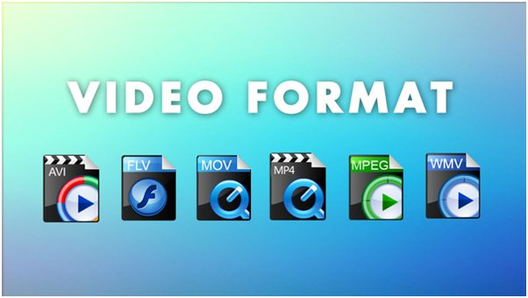
VIDEO FORMATS
Video Formats:
Definition: Store sequences of images (frames) with or without audio.
Examples:
MP4 (MPEG-4 Part 14): Common video format that supports high quality and compression.
AVI (Audio Video Interleave): An older format that supports various codecs.

Slide 11
Exploring the Fundamentals of Digital Imagery: Pixels, Resolution, Color Models, and Bit Depth

Slide 12

Exploring Digital Imagery Fundamentals
Discover the core concepts of digital imagery, including a
pixels,resolution and color models.
Understand how these elements work together to create the digital
images we encounter daily.

Slide 13
Understanding Pixels and Resolution
Explore the basic building blocks of digital imagery -pixels. Learn how the number and density of pixels, or resolution, impact the quality and clarity of digital images.

Slide 14
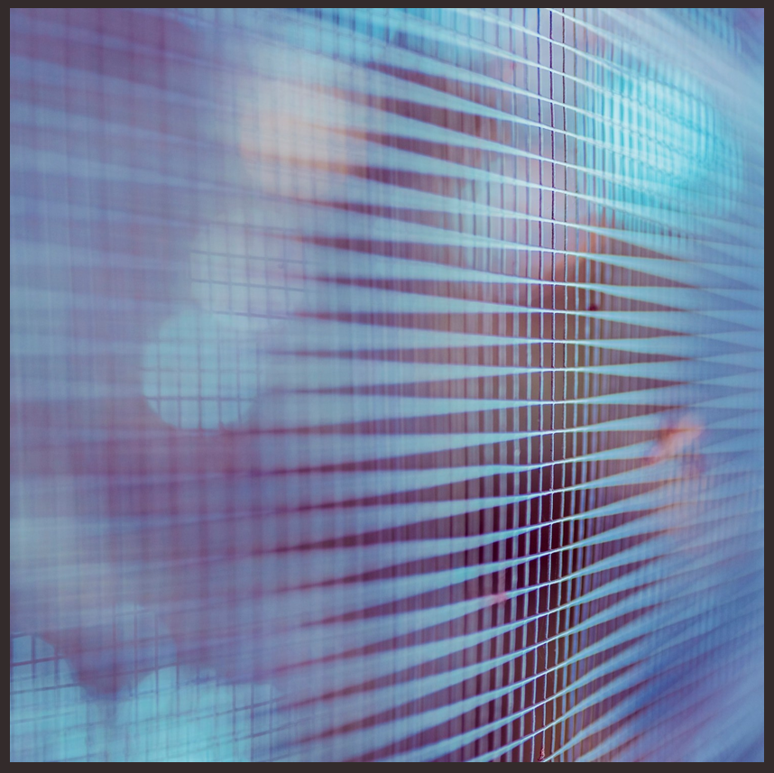
Understanding Pixels and Resolution
Understand the importance of selecting the appropriate resolution for your needs.

Slide 15

Exploring Color Models and Bit Depth
Delve into the world of color models, such as RGB and CMYK, and how they represent the vast spectrum of colors in digital images. Understand bit depth, which determines the number of colors an image can display, and its impact on image quality and ﬁle size.

Slide 16
Conclusion: Mastering Digital Imagery
In summary, the fundamental concepts of pixels , r e s o l u t io n ,c o l o r m o d e l s , and bit depth are the building blocks of digital
imagery.

Slide 17
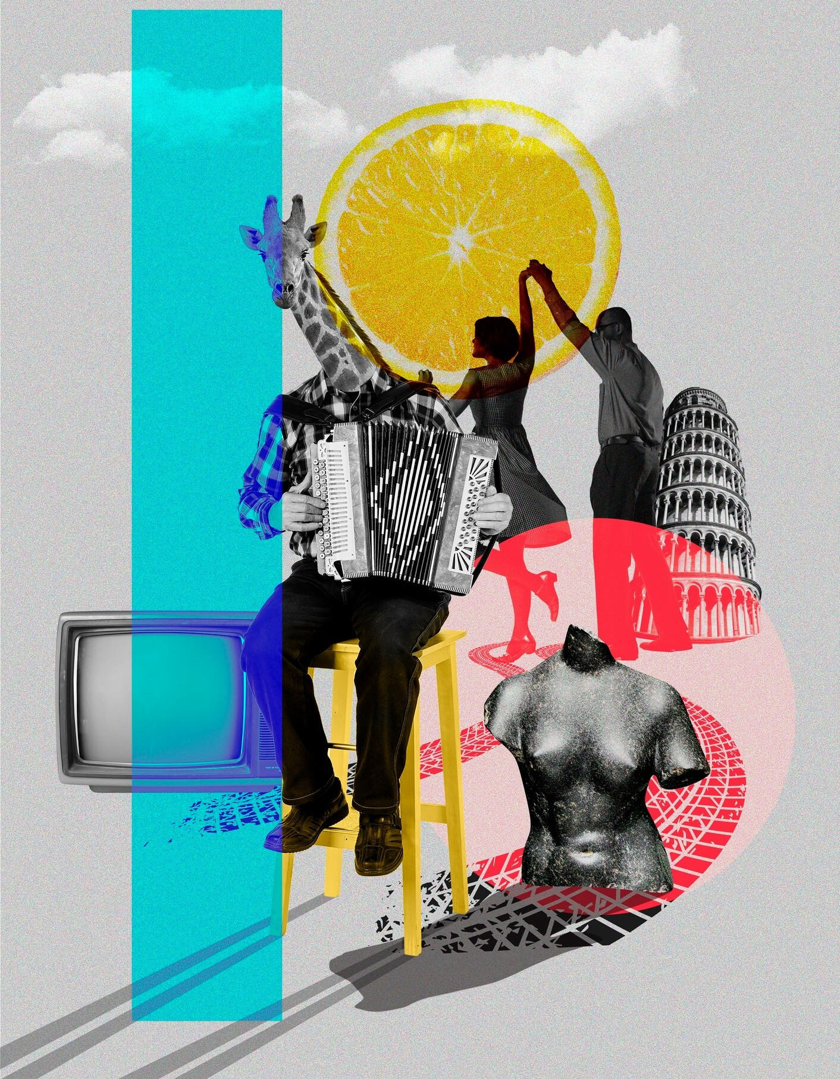
Conclusion: Mastering Digital Imagery
By understanding these elements, you can create, manipulate, and optimize digital images for various applications and industries.

Slide 18
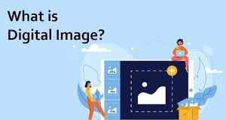
Digital Images
A digital image is a representation of a two-dimensional visual object in a digital format. It is composed of pixels (in the case of raster images) or paths defined by mathematical equations (in the case of vector images).

Slide 19
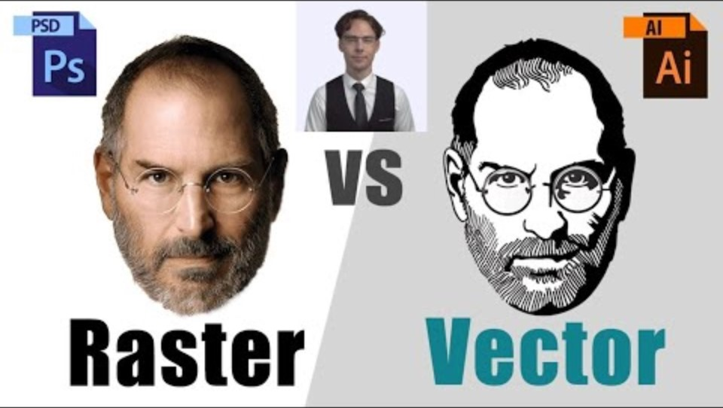
Image Types
Raster Images:
Pixel-based
Resolution-dependent
Suitable for detailed and complex images
Vector Images:
Path-based
Resolution-independent
Suitable for images with sharp edges and flat colors

Slide 20
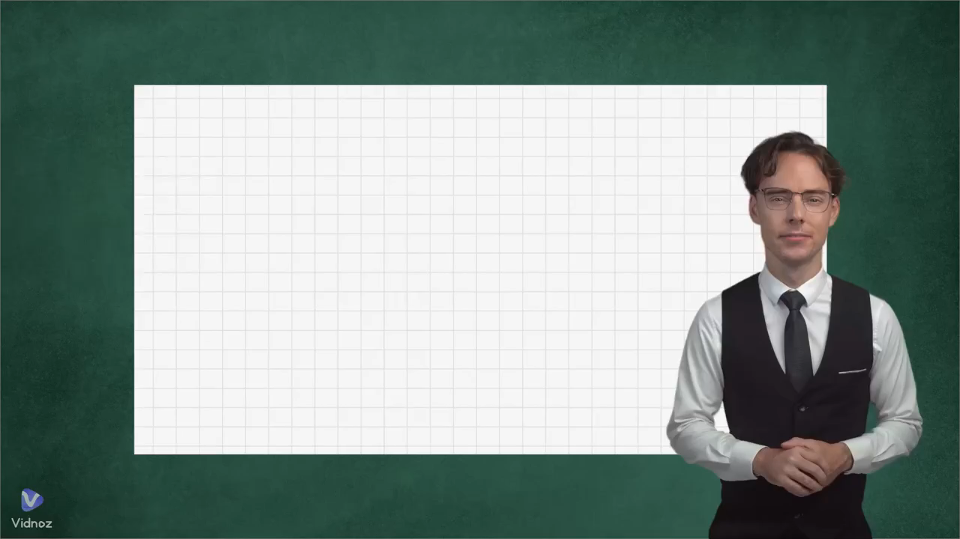

Slide 21
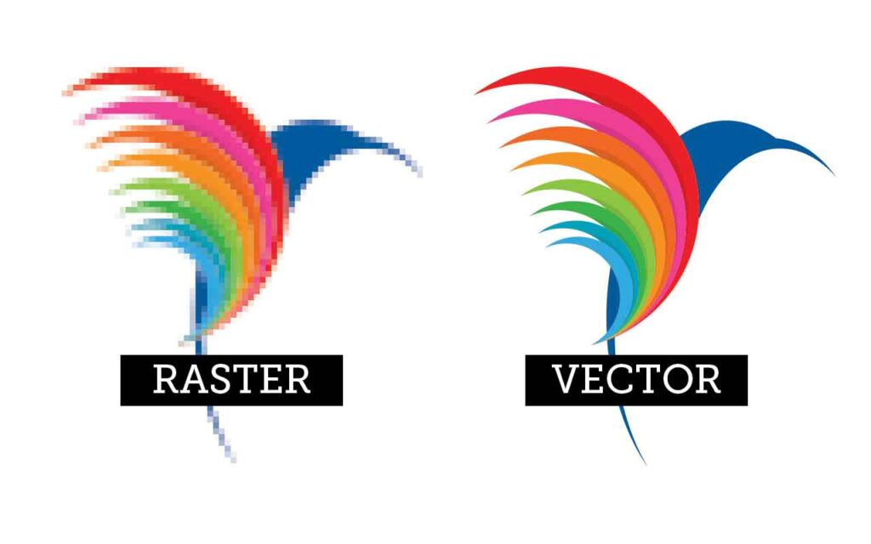
Difference on Characteristics of Images
Raster Images
Vector Images
Composed of pixels in a grid.
Resolution-dependent; quality degrades when scaled up.
Composed of paths defined by mathematical equations.
Resolution-independent; quality remains consistent when scaled up.

Slide 22
Difference on Common Formats Images
Raster Images
Vector Images
JPEG (Joint Photographic Experts Group): Commonly used for photographs and images with many colors and gradients.
PNG (Portable Network Graphics): Supports lossless compression and transparency.
SVG (Scalable Vector Graphics): XML-based format for web use. Supports interactivity and animation.
PDF (Portable Document Format): Can contain both vector and raster data. Commonly used for documents and graphics.

Slide 23

Raster Images
Raster images, also known as bitmap images, are composed of individual pixels. Each pixel has a specific color value and position within the grid that forms the image.

Slide 24
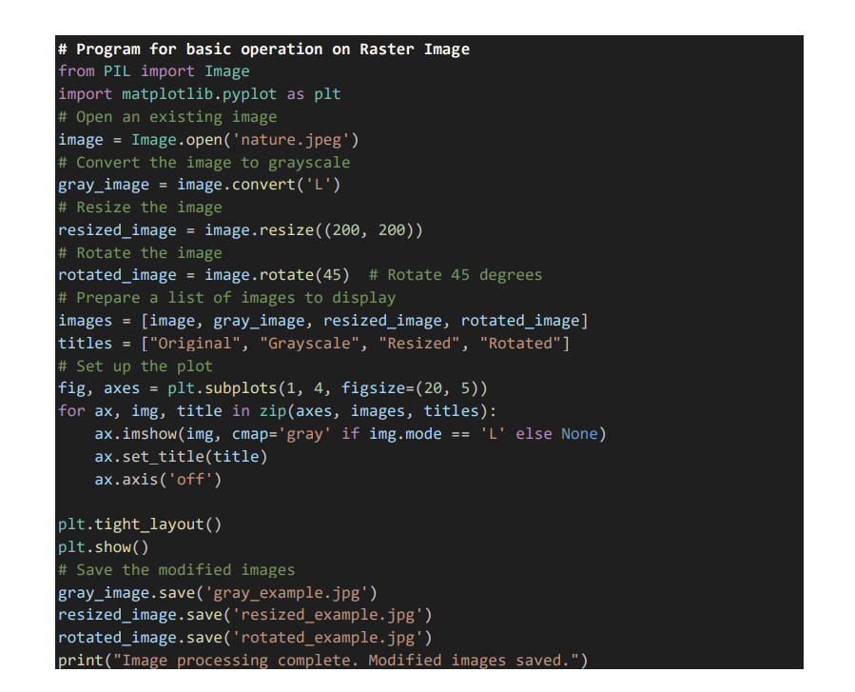
Raster Program
This Python code performs basic
Image processing operations using
the PIL (Pillow) and matplotlib
libraries. It begins by opening
an existing image file named
nature.jpeg. The code then
converts this image to grayscale,
resizes it to 200x200 pixels, and
rotates it by 45 degrees. These
modified images , along with the
original image, are
stored in a list.

Slide 25
Raster Program
The images are then displayed in a
single row using matplotlib with
titles "Original", "Grayscale",
"Resized", and "Rotated" to
indicate their respective
transformations. The display is
formatted to fit tightly within the
plotting window. After displaying
the images, the grayscale, resized,
and rotated versions are saved as
gray_example.jpg,
resized_example.jpg, and
rotated_example.jpg, respectively.

Slide 26
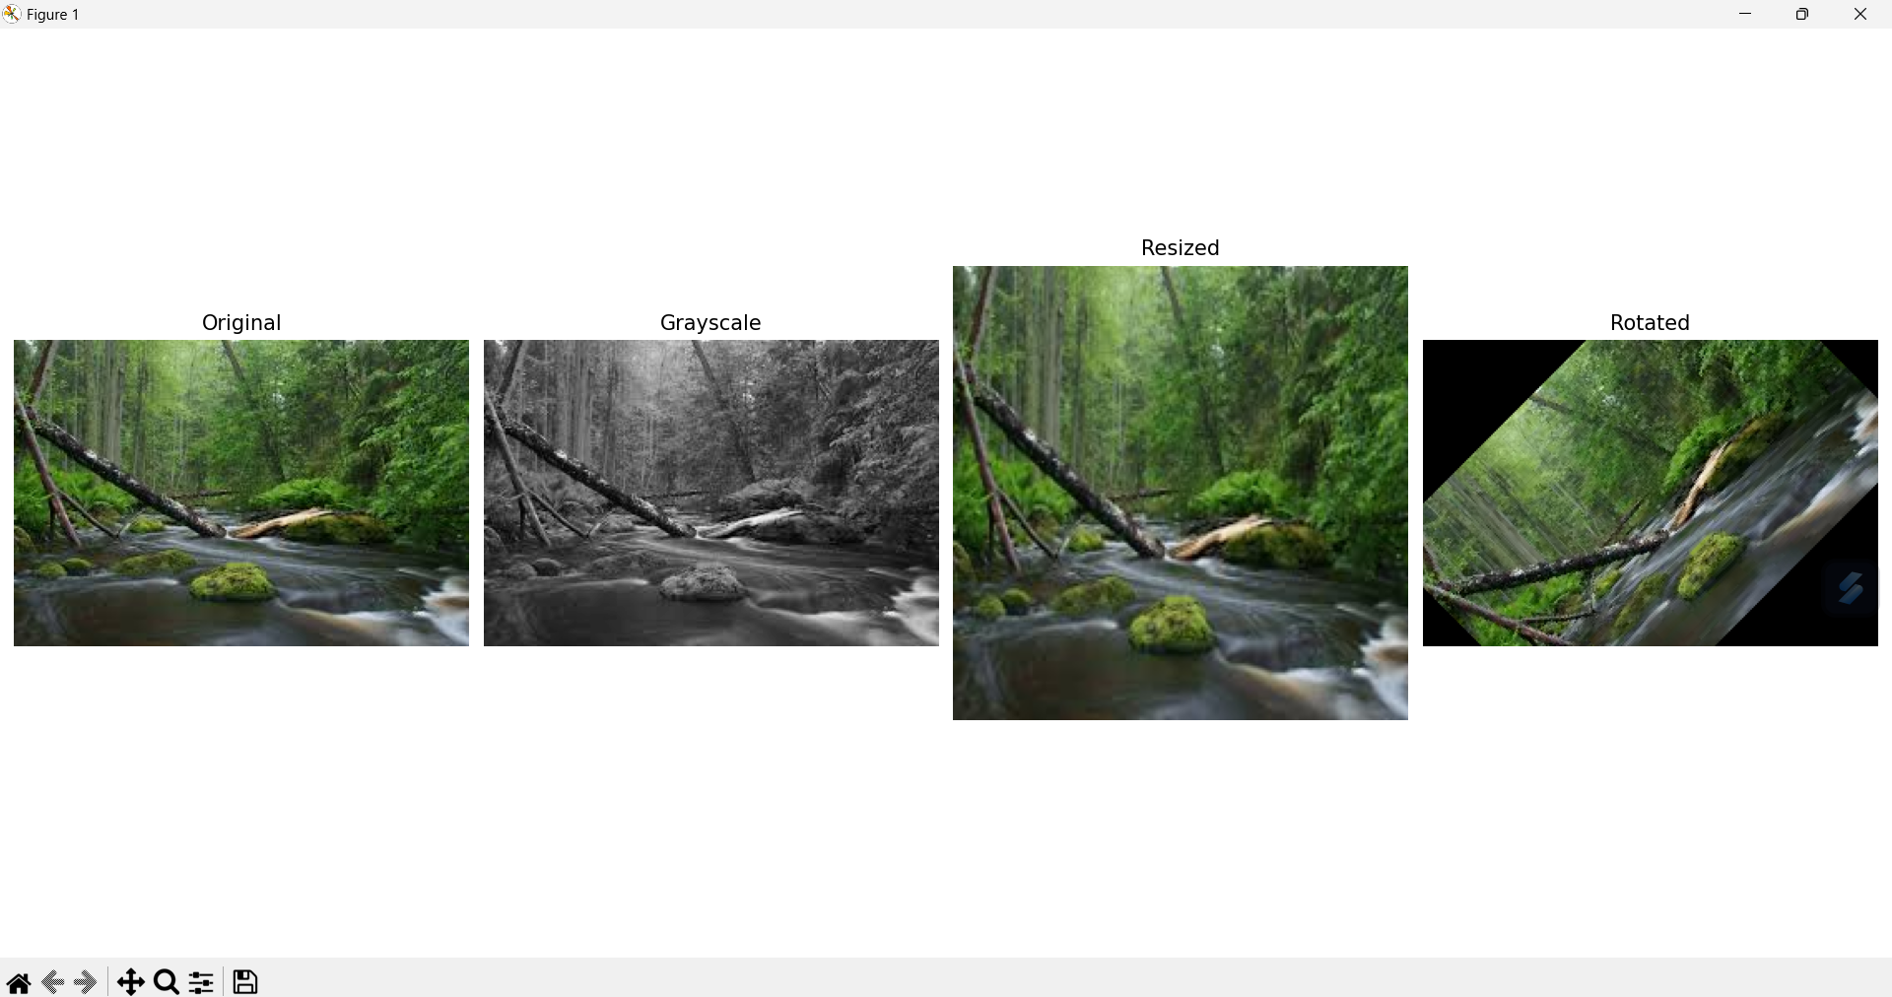
Basic Function Raster Output

Slide 27

Vector Images
A vector image is a type of digital graphic that is created using mathematical equations rather than individual pixels.

Slide 28
Vector Images
Vector images are composed of paths defined by a start and end point, along with other points, curves, and angles. These paths can create simple or complex shapes and are scalable to any size without losing quality or clarity.

Slide 29
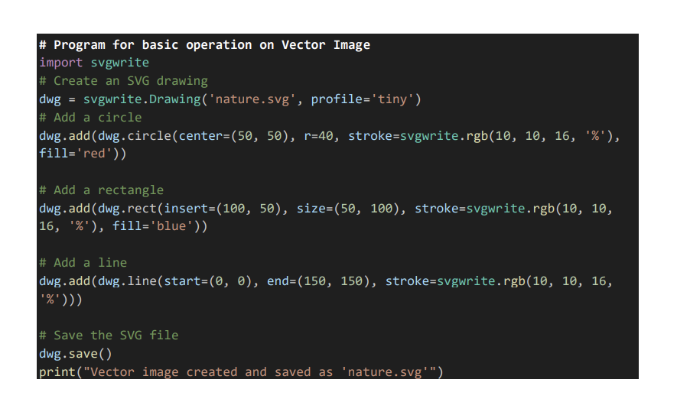
Vector Program
This Python code utilizes the
svgwrite library to create a simple
vector image in SVG (Scalable
Vector Graphics) format. It begins
with nature.svg then adds three
basic shapes to the drawing: a red
circle centered at (50, 50) with a
radius of 40 pixels, a blue rectangle
positioned at (100, 50) with
dimensions 50x100 pixels, and a
line drawn from the coordinates (0,
0) to (150, 150), all with specified
stroke colors.

Slide 30
Vector Program
Each shape is added to the SVG
drawing using svgwrite methods
such as add(), circle(), rect(), and
line(). Finally, the drawing is saved
to the file nature.svg, and a
confirmation message is printed to
indicate the successful creation and
saving of the vector image. This
code demonstrates the basic use of
vector graphics to create scalable
and easily editable shapes, suitable
for various applications such as
web graphics and illustrations.

Slide 31
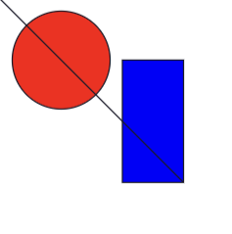
Basic Function Vector Output

Slide 32
Conclusion
Raster Images:
Pixel-based
Resolution-dependent
Suitable for detailed and complex images
Common formats: JPEG, PNG, BMP, GIF
Vector Images:
Path-based (mathematical equations)
Resolution-independent
Suitable for images with sharp edges and flat colors
Common formats: SVG, EPS, PDF

Slide 33
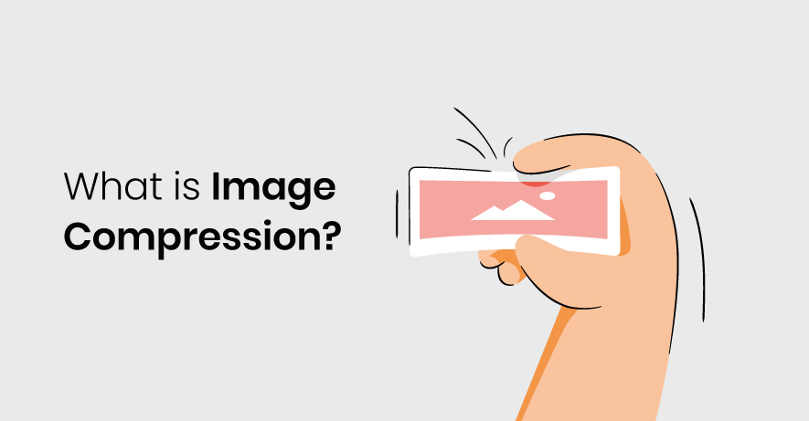

Slide 34
Image compression refers to the process of reducing the size of a digital image file without excessively degrading its quality. This reduction in size is achieved by using various algorithms and techniques that remove redundant or unnecessary data from the image file.

Slide 35

Primary Goals of Image Compression

Slide 36
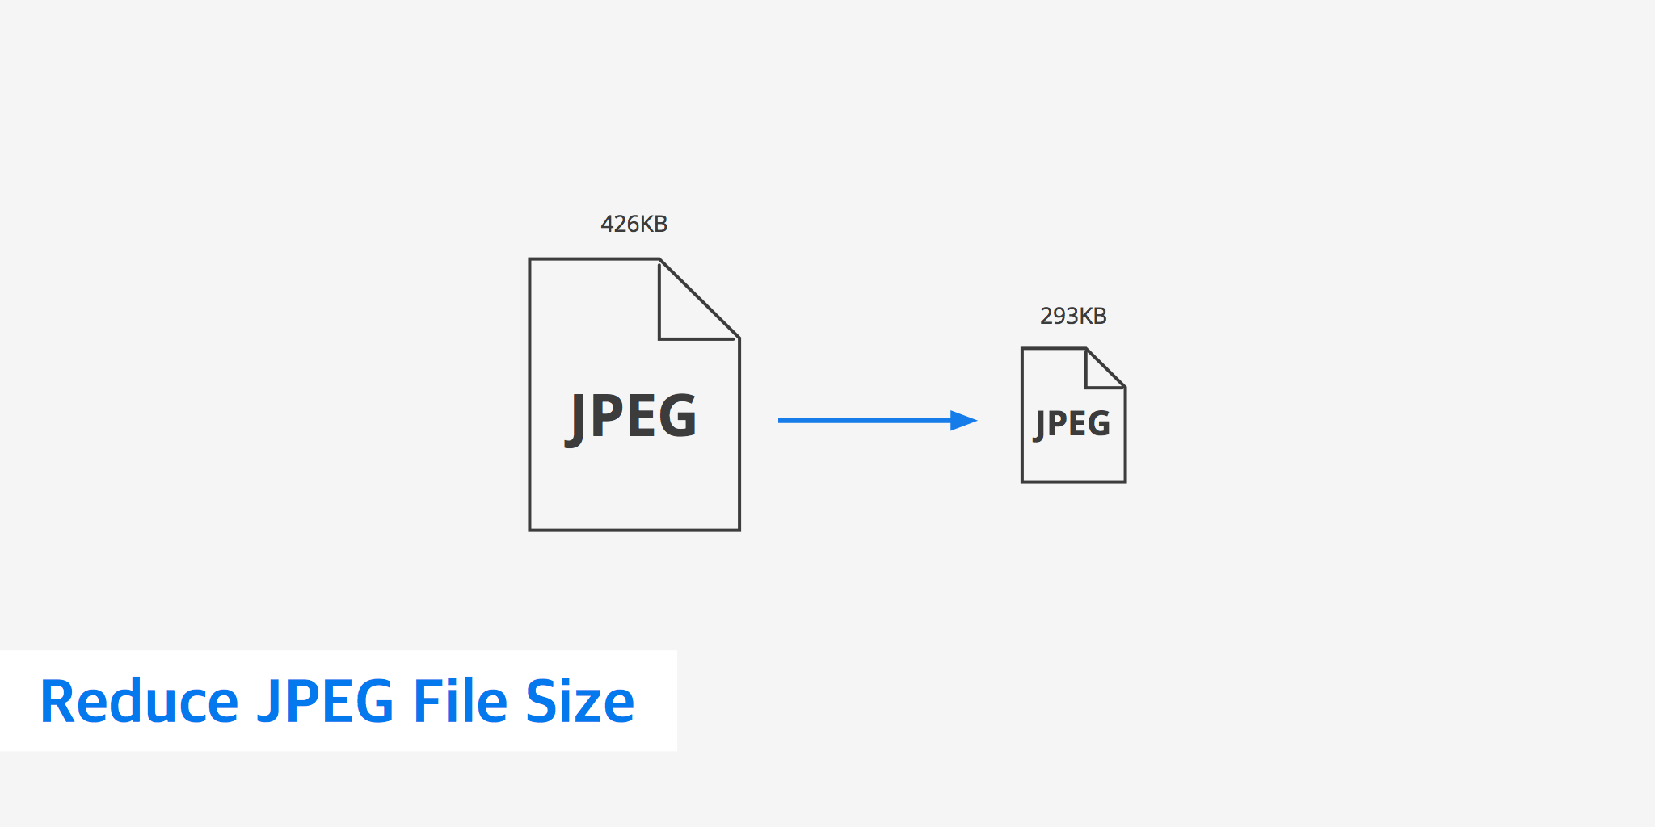
Reducing File Size: By compressing an image, fewer bytes are required to store it, which saves storage space and allows for faster transmission over networks.

Slide 37
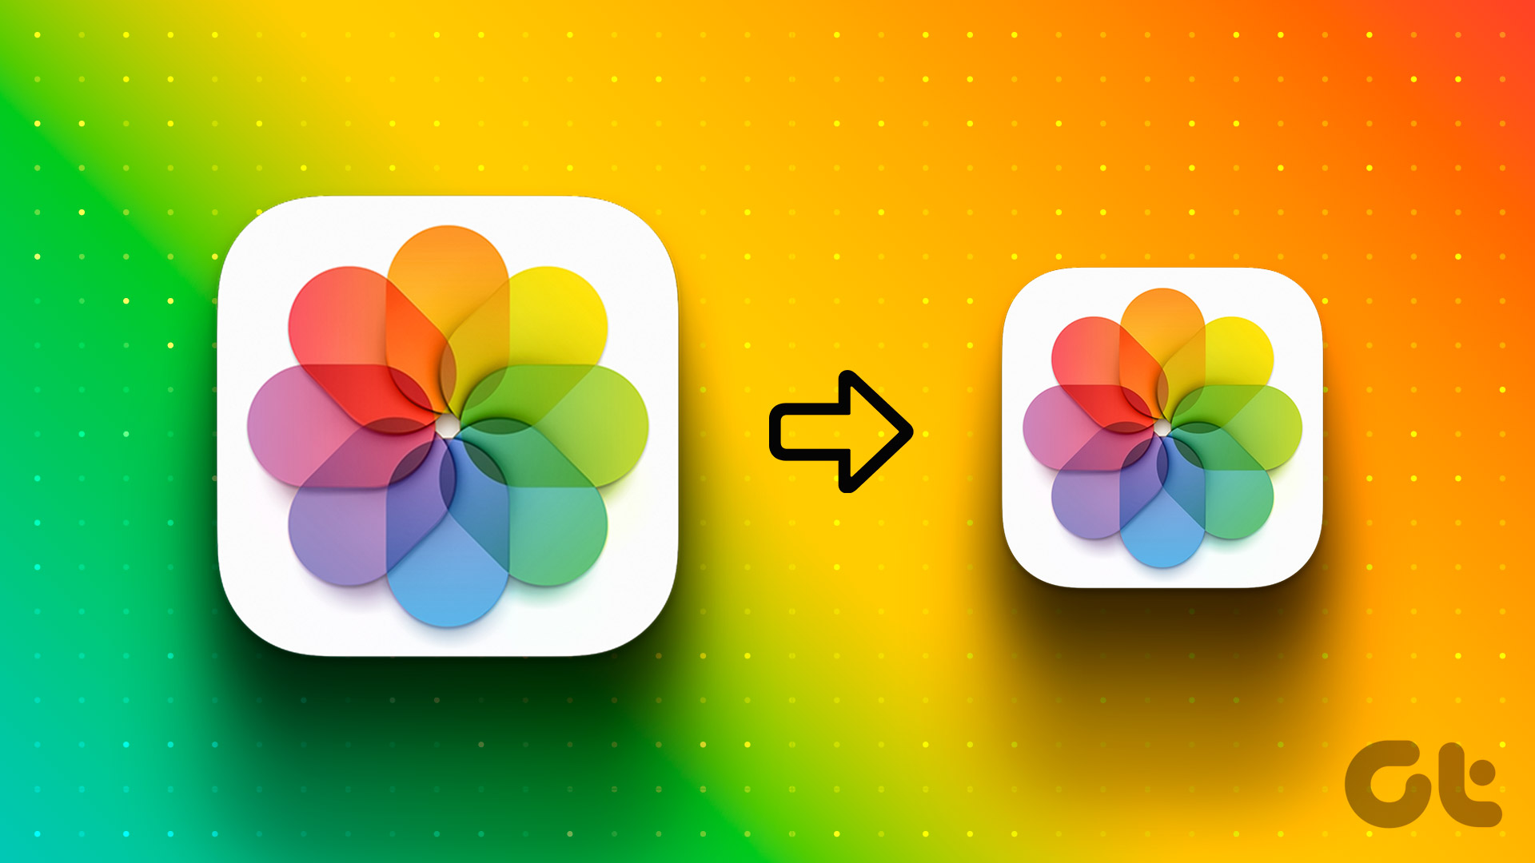
Maintaining Quality: Depending on the type of compression used (lossless or lossy), the goal is to minimize perceptible loss in image quality while achieving significant reductions in file size.

Slide 38

Key Concepts of Compression

Slide 39
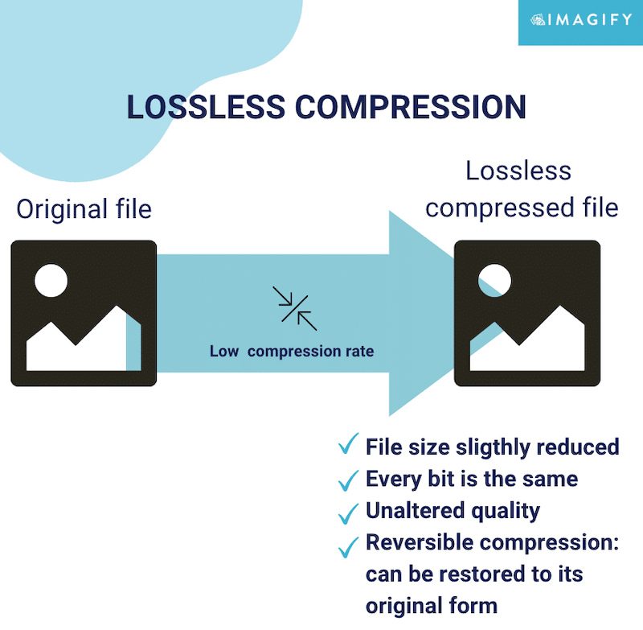
Lossless Compression: Description: Lossless compression reduces the file size of an image without losing any information or quality. When the image is uncompressed, the original data is perfectly reconstructed.

Slide 40
Examples of Techniques: Run-Length Encoding (RLE): Encodes sequences of the same pixel value into a single data value and count pair. Lempel-Ziv-Welch (LZW): Similar to RLE but also includes a dictionary-based compression method. Predictive Coding: Uses algorithms that predict values of pixels based on neighboring pixels, thus encoding only the difference between predicted and actual values.

Slide 41
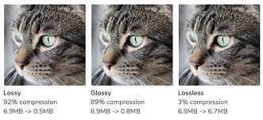
Lossy Compression: Description: Lossy compression reduces the file size by permanently eliminating certain information that the human eye may not easily perceive. This results in some loss of image quality, but the degree of loss can be controlled by adjusting compression parameters.

Slide 42
Examples of Techniques: Discrete Cosine Transform (DCT): Converts spatial image data into frequency data, where higher frequency components (less perceptually important) can be discarded or quantized more heavily. Quantization: Reduces the precision of the data representation. For example, reducing color depth or precision of pixel values. Chroma Subsampling: Reduces color information by storing less data for certain color channels, particularly in formats like JPEG.

Slide 43
THANK YOU

